Slide 1
Deprecations & Removals

Slide 2
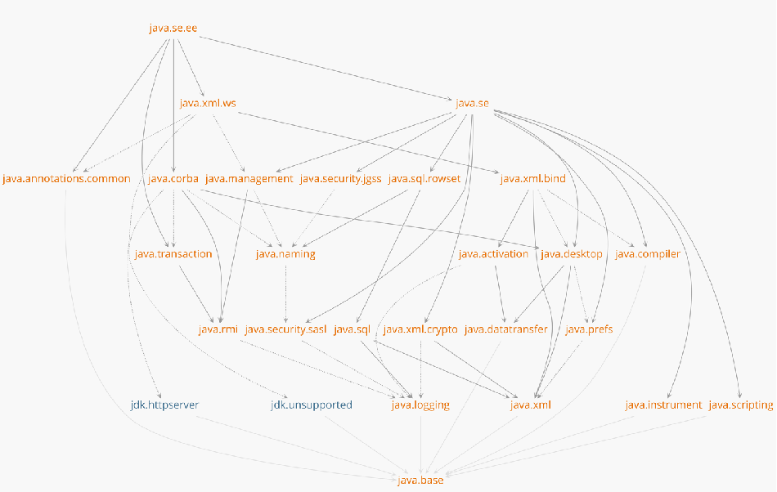
Modularized JDK

Slide 3
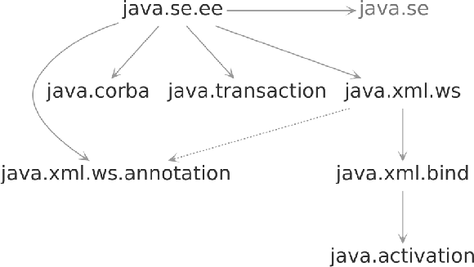
Removed Enterprise APIs
JAXB
...
...
...
JAX-WS
JAX-WS Annotations
CORBA
JTA
JavaBeans Activation

Slide 4
Removed Enterprise APIs: Alternatives
java.xml.bind
<dependency>
<groupId>javax.xml.bind</groupId>
<artifactId>jaxb-api</artifactId>
</dependency>
JAXB
<dependency>
<groupId>com.sun.xml.bind</groupId>
<artifactId>jaxb-impl</artifactId>
</dependency>
JEP 320: openjdk.java.net/jeps/320

Slide 5
Removed Methods
Thread
countStackFrames() destroy()
resume() stop()
stop(Throwable obj) suspend()
java.lang.System::runFinalizersOnExit
java.lang.Runtime::runFinalizersOnExit

Slide 6
Removed Methods
SecurityManager
checkAwtEventQueueAccess checkSystemClipboardAccess checkTopLevelWindow checkMemberAccess
checkPermission(java.security.Permission)

Slide 7
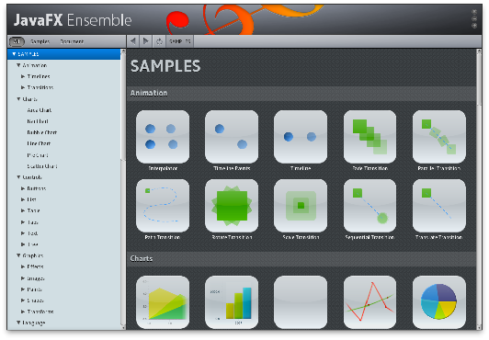
JavaFX
Part of Oracle JDK 8, 9 & 10
Java 11: no longer bundled
OpenJFX

Slide 8
JavaFX on Maven Central
<dependency>
<groupId>org.openjfx</groupId>
<artifactId>javafx</artifactId>
<version>11-ea+19</version>
</dependency>
javafx-base, javafx-controls, javafx-media

Slide 9
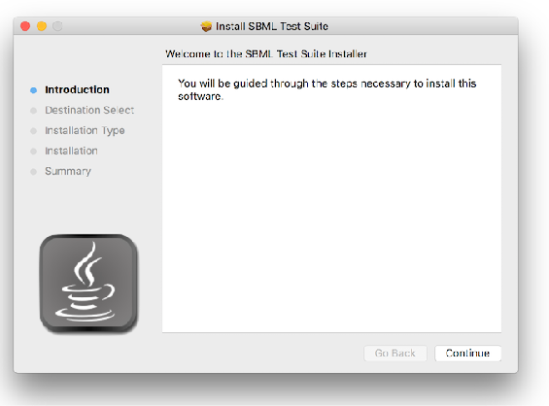


JavaFX: Javapackager
Native (MSI/DMG) installers
Removed in Java 11
Draft proposal jpackager

Slide 10



Removed & Deprecated Technologies
Applets
Java Web Start
Nashorn
Java 8 Commercial Support
jlink jpackager?
Graal.js
Project Detroit (Google V8)
bit.ly/clientroadmap

Slide 11



Removed: Enterprise APIs
Summary
JavaFX moved out of JDK
Removed: Applets, Web Start

